Slide 1
Power System Fault Detection and Classification
CAPSTONE PROJECT
Presented By:-Prem Kishor Lode
College Name:-Wainganga College of Engineering and Management
Department:-Computer Science and Engineering

Slide 2
OUTLINE
Problem Statement (Should not include solution)
Proposed System/Solution
System Development Approach (Technology Used)
Algorithm & Deployment
Result (Output Image)
Conclusion
Future Scope
References

Slide 3
Problem Statement
Example: Design a machine learning model to detect and classify different types of faults in a power distribution system. Using electrical measurement data (e.g., voltage and current phasors), the model should be able to distinguish between normal operating conditions and various fault conditions (such as line-to-ground, line-to-line, or three-phase faults). The objective is to enable rapid and accurate fault identification, which is crucial for maintaining power grid stability and reliability.

Slide 4
Proposed Solution
Data Collection:
Collect voltage and current phasor measurements form sensors or PMUs in the power system.
Future Extraction:
Calculate RMS values, phase angles, and symmetrical components (positive, negative, zero sequences).
Watsonx AI Model Training:
Train a multi-class classification model to detect :
Normal Condition
LG fault
LL fault
LLG fault
LLL fault
Fault Classification:
Watsonx AI analyzes real-time data and classifies fault type instantly .
Integration with SCADA/IoT:
Send alerts to operates .
Trigger protective devices for automatic fault isolation.

Slide 5
System Approach
Data Pipeline:
Step1-Collect phasor data from PMUs.
Step2-Preprocess(normalise , remove noise , label faults).
Model Workflow :
Training : Use Watsonx AutoML for hyperparameter tuning.
Validation: Cross-validation with historical faults datasets.
Deployment :
Edges device for real-time monitoring + cloud for model updates.

Slide 6
Algorithm & Deployment
Algorithm: Watsonx AI Multi-Class Classification
Data Acquisition:
Voltage and current phasors from sensors or PMUs.
Feature Engineering :
RMS voltage/current ,phase angles, sequence components.
Model Training in Watsonx AI:
Use AutoAI or Custom ML Model in Watsonx.ai for multi-class classification.
Classes : Normal ,LG,LL,LLG,LLL.
Model Evaluation :
Metrics : Accuracy , F1-score,Confusion Matrix.
Deployment:
Deploy trained model on Watsonx.ai endpoint.
Real-time SCADA/IoT integration for automatic alerting & fault isolation

Slide 7
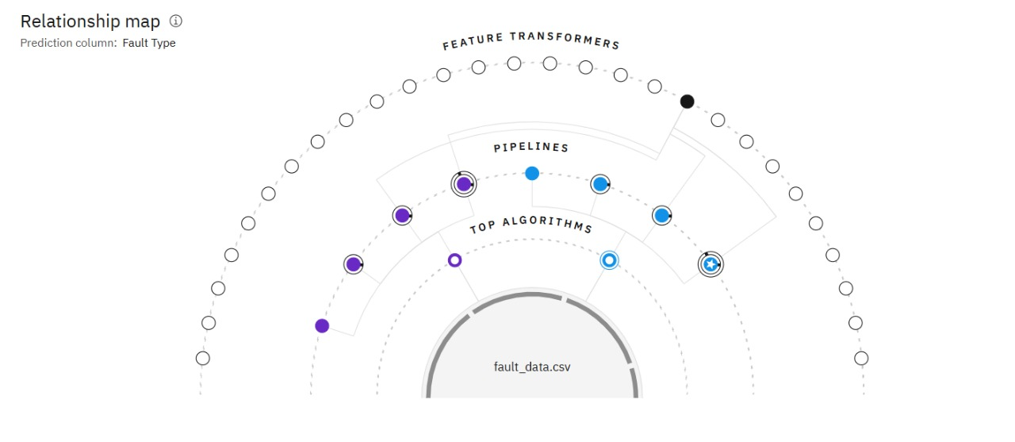
Result

Slide 8
Conclusion
Watsonx AI-based model successfully classifies different types of faults in the distribution system.
Enables Fast faults isolation and reduces downtime.
Provides high accuracy and scalability for smart grids.

Slide 9
Integrate real-time PMU and SCADA data for instant decision making.
Add predictive maintenance using AI for future fault prevention.
Extend to smart grid and renewable energy monitoring.
Deploy edge AI models for ultra-low latency fault detection.
Future scope

Slide 10
References
IBM Watsonx.ai Documentation.
IEEE Research Papers on Fault Classification in Power systems.
MATLAB/Simulink Simulation Data for Power Faults.
SCADA and smart grid IoT Monitoring Literature.

Slide 11
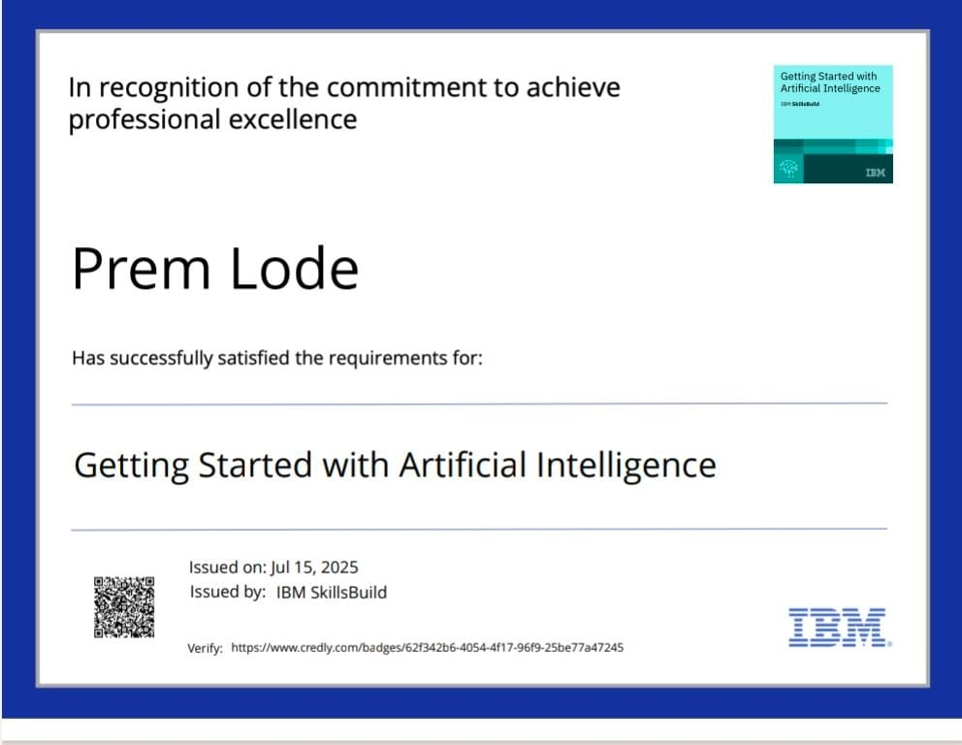
IBM Certifications

Slide 12
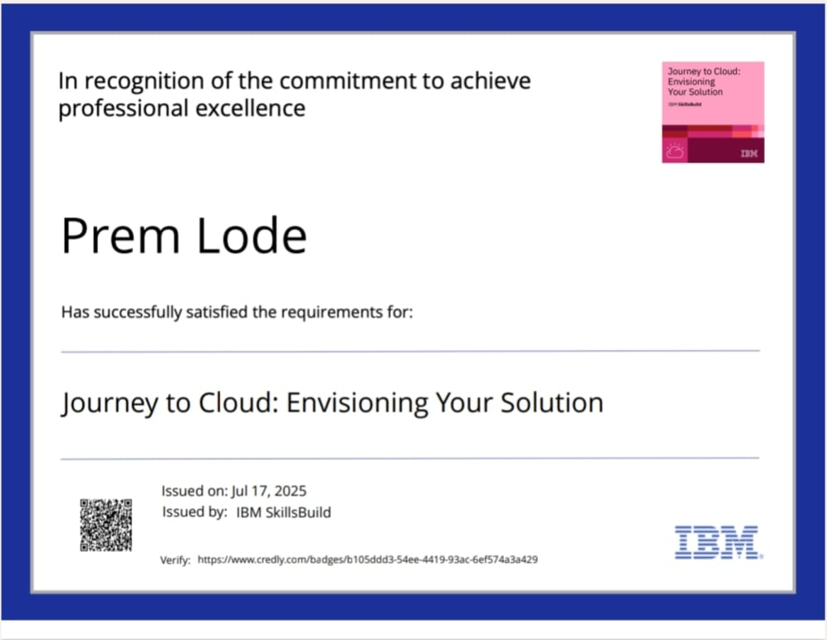
IBM Certifications

Slide 13
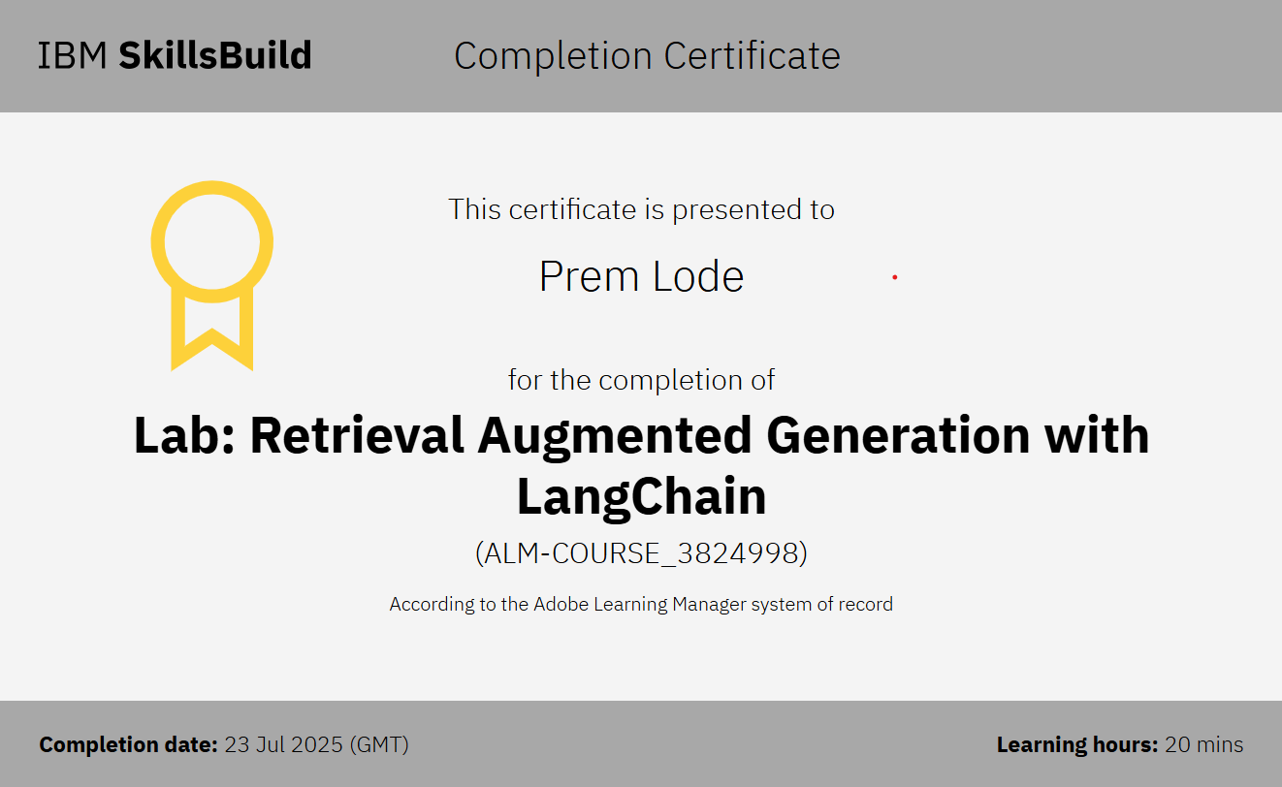
IBM Certifications

Slide 14
THANK YOU

